Slide 1

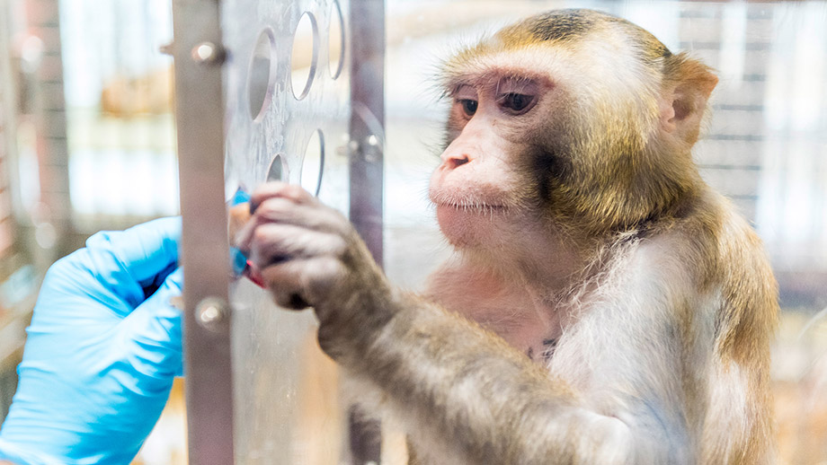
Animal Training
Regulations, Policies and Recommendations
Photo credit: University of Zurich

Slide 2



Human-Animal Relationship & Welfare
Training and interactions with staff can have significant positive or negative impacts on the psychological and physiological state of an animal.
How can we objectively & consistently assess psychological state in response to training?
Studies show that using PRT techniques to train voluntary cooperation can significantly affect physiological measures that are correlated with stress responses
Total WBC counts, blood GLU levels, and SEG levels were significantly lower in animals that voluntarily presented than in animals that received an injection involuntarily or were darted.
Lambeth et al, Positive Reinforcement Training Affects Hematologic and Serum Chemistry Values in Captive Chimpanzees, American Journal of Primatology 68:245-256 (2006).

Slide 3
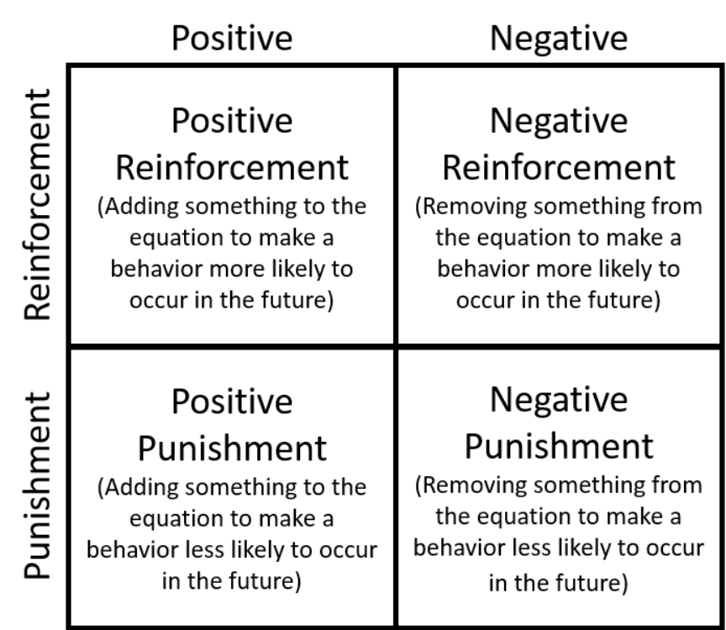
Operant Conditioning
A type of learning in which the probability of a behavior recurring is increased or decreased by the consequences that follow.
Ample & clear communication during the training process is critical for the animal to learn and understand what is being asked of them.

Slide 4
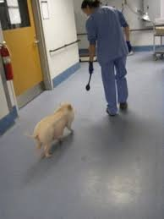
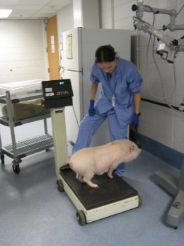
Positive Reinforcement Training
Animals learning with PRT and a conditioned reinforcer learn faster and remember better than animals learning with only primary reinforcers due to activation of the core emotional SEEKING system (e.g. Pryor, 2009).
PRT triggers a dopamine cascade which affects the brain as an “anticipation of good news”.
Correction involving strong aversive (positive punishment and negative reinforcement) switches the brain from SEEKING mode to avoidance and fear (Dickinson and Pearce, 1977; Pryor, 2009).

Slide 5
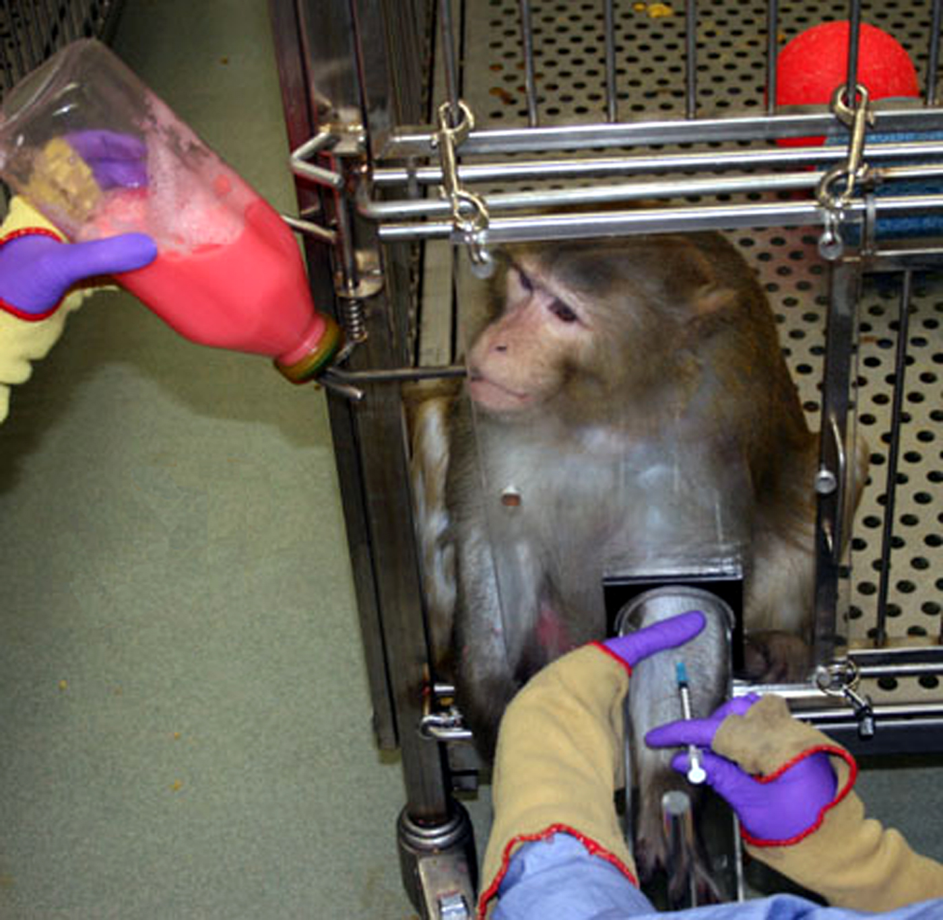
Desensitization & Habituation
Desensitization – The process of exposing an individual to an anxiety-provoking stimulus in a stepwise manner while a state of relaxation is maintained. Important to always keep the stimulus below the threshold that causes anxiety.
Habituation- Learning occurs through passive exposure to an aversive stimulus over time.
Counterconditioning- The aversive stimulus is explicitly paired with positive reinforcement.
Flooding (NOT RECOMMENDED)- prolonged and intense exposure to a fear inducing stimulus intending to force habituation.
Some animals may seem behaviorally unaffected by aversive stimuli but still react physiologically.
Learned helplessness may be confused with compliance.
Stress may still be a confounding factor in research results.

Slide 6
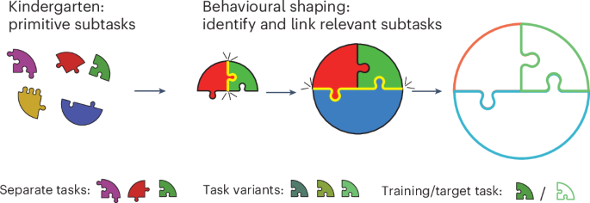
Approximations (Shaping)
Slowly develop the desired behavior. Reward the behavioral steps which approach the desired end goal behavior. Complicated behaviors should be broken down into manageable smaller steps.
Using stepwise, approximations provides a foundation for the goal behavior and slowly builds confidence and trust, without flooding or overwhelming the learner.
Do not continuously push an unsuccessful command. If the animal does not cooperate or understand what is required of it, revert to a previously learnt command to rebuild confidence.
Hocker, D., Constantinople, C.M. & Savin, C. Compositional pretraining improves computational
efficiency and matches animal behaviour on complex tasks. Nat Mach Intell 7, 689–702 (2025).

Slide 7
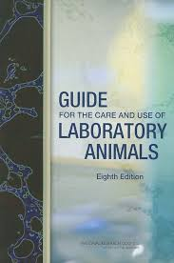
The Guide for Care and Use of Laboratory Animals
Habituating animals to routine husbandry or experimental procedures should be encouraged whenever possible.
The type and duration of habituation needed will be determined by the complexity of the procedure. In most cases, principles of operant conditioning may be employed during training sessions, using progressive behavioral shaping, to induce voluntary cooperation with procedures
Notes:
(Bloomsmith et al. 1998; Laule et al. 2003; NRC 2006a; Reinhardt 1997).National Academies of Sciences, Engineering, and Medicine. 2011. Guide for the Care and Use of Laboratory Animals: Eighth Edition. Washington, DC: The National Academies Press. https://doi.org/10.17226/70.

Slide 8
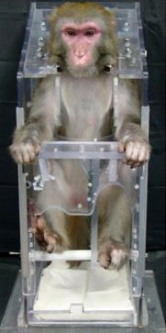
Restraint
Restraint devices should be suitable in size, design, and operation to minimize discomfort, pain, distress, and the potential for injury to the animal and the research staff.
The period of restraint should be the minimum required to accomplish the research objectives.
Animals to be placed in restraint devices should be given training (with positive reinforcement) to adapt to the equipment and personnel.
–The Guide, page 29
Feng Zhao, et al. Improved methods for electroacupuncture and electromyographic recordings in normal and parkinsonian rhesus monkeys, Journal of Neuroscience Methods, Volume 192, Issue 2,2010, Pages 199-206,

Slide 9

OLAW & PHS Assurance
The U.S. Government Principles¹, Health Research Extension Act of 1985² and the PHS Policy³ repeatedly state that personnel must be appropriately trained, qualified, and experienced, and that proper instruction and training must be provided.
IACUCs are responsible for verifying that individuals listed in animal activities will be appropriately qualified and trained prior to engaging in animal activities.
While training is an institutional responsibility, IACUCs are required to evaluate the effectiveness of the institutional training program
Procedures with animals will avoid or minimize discomfort, distress, and pain to the animals, consistent with sound research design.

Slide 10

AAALAC International
The 3 R’s: Refinement must also be considered to minimize pain and distress and provide positive experiences to enhance animal welfare throughout the animals’ lifetime. Examples may include, but are not limited to, social housing, biologically relevant enrichment, acclimation, habituation, positive reinforcement training and other welfare improvements to experimental procedures, housing, and handling. As refinements evolve, personnel should have access to current refinement training and educational opportunities.
The institutional Animal Care and Use Committee or Oversight Board (IACUC/OB) should identify appropriate performance criteria, as well as a process for assessment, and ensure that the adequacy, safety, comfort and configuration of the animal environment is regularly reviewed to meet animal welfare and research quality needs. Animals should be adequately acclimated to their environment, as well as habituated to handling before experimentation begins to reduce stress as well as experimental variability. Non-aversive animal handling and positive reinforcement training methods should be used whenever possible to minimize stress and it should be performed by adequately trained personnel.

Slide 11
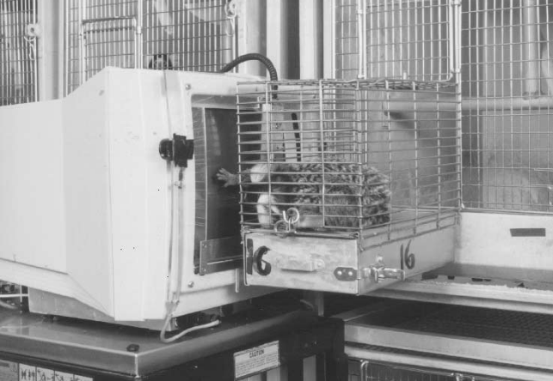
Guidelines for the Care and Use of Mammals in Neuroscience and Behavioral Research
Open communication and cooperation between the veterinary staff and the investigative staff regarding innovations in technique are essential to ensure the most up-to-date and refined use of animals. Evaluation of outcomes and results is critical in assessing technical experience and the need for training.
Observation of an animal during restraint is critical and should be thoroughly described in the animal-use protocol.
Criteria for the temporary or permanent removal of an animal from a study that requires restraint must be developed in advance of the study.
Well qualified personnel will have a sound understanding of when restraint should be suspended or stopped if it compromises animal welfare.
Scott, Leah. Training Nonhuman Primates to Cooperate With Scientific Procedures in Applied Biomedical Research, JOURNAL OF APPLIED ANIMAL WELFARE SCIENCE, 6(3), 199–207

Slide 12

NC3Rs - PRT
In some situations, using PRT requires more training time than the use of more traditional training methods that depend primarily on negative reinforcement.
Negative reinforcement (NR) relies on removing an unpleasant action or aversive stimulus immediately after the desired behavior occurs. A common negative reinforcement method in the laboratory is using a cage “squeeze back” to move an animal into position for a procedure and then releasing the squeeze back as soon as the needed behavior is performed. This type of training is effective but is less desirable because it reduces the animals’ choice and control and may involve coercion. When PRT cannot practically accomplish what is needed in a reasonable timeframe, it is possible to use NR in conjunction with PRT to speed up the training process.
Chair-training procedures should be based on operant conditioning and positive reinforcement, not merely passive habituation through repeated exposure.
Notes:
Often, the initial training will take investment, but the ingrained learning will payoff and expedite continued training and learning and provide the foundation to fall back on in cases of regression or aversive experiences.

Slide 13
IACUC Policy:
Physical Restraint of Animals
When considering physical restraint, the Pl must ensure and demonstrate to the IACUC that:
The method of restraint is appropriate for the species of animal.
The period of restraint is the minimum required for experimental objectives.
The degree of immobility is the minimum required for experimental objectives.
The personnel performing the restraint have been appropriately trained; and,
When prolonged physical restraint is necessary, the physical, physiological, and psychological effects to the animal are minimized.
For prolonged restraint, the IACUC protocol section for Physical Restraint must include:
A description of the device.
A justification for use. Justification may be scientific, welfare, or safety related. Convenience is not an adequate justification for prolonged restraint.
The duration of restraint, including related monitoring procedures and methods to minimize animal distress (e.g., timing, documentation, and exclusionary criteria of acclimation to the device).
A description of animal acclimation or training to restraint methods and how it is documented by the lab.

Slide 14
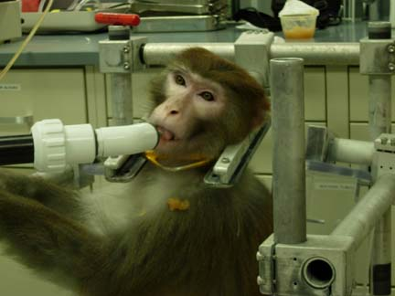
IACUC Policy:
Physical Restraint of Animals
Acclimation, habituation, or training to restraint methods is required for studies involving prolonged restraint. The acclimation protocol, along with criteria to evaluate the animal's response to being restrained, must be described in the IACUC protocol. The Pl must document each animal's behavioral response to the acclimation protocol to demonstrate that the animals adapt well to the restraint device. This information must be readily available for review by a veterinarian or the IACUC. Animals that do not adapt to such systems must be removed from the study.
(Photo by Michelle Walsh)

Slide 15
Summary
Positive Reinforcement Training (PRT) and operant conditioning support voluntary cooperation, improve welfare, and reduce stress‑related impacts on research outcomes.
Habituation, desensitization, shaping, and counterconditioning should be used to acclimate animals to handling, procedures, and restraint.
Voluntary participation and minimized restraint reduce distress, improve safety for staff, and decrease experimental variability.
Coercive or aversive techniques may impair learning, increase fear and stress, and negatively affect animal welfare and data quality.
Regulatory guidance (Guide, OLAW/PHS, AAALAC, NC3Rs) requires trained personnel, documented acclimation and restraint plans, and ongoing assessment of training effectiveness.

Slide 16

Oversight & Refinement
How can we enhance our program?
Protocols- Must include description of methods of training
  Is the information provided consistent?
  Is enough detail provided to give a clear picture of the training?
  PAM- are training records or processes reviewed/reassessed?
Training- Required modules & lab specific training
  Is there consistency across labs with individual training?
  Animal Training concepts & methods provided?
  PAM- are all staff adequately trained in current, proper methods and demonstrate proper human behavior when working with the animals?
Improvements to refine our program
  Standardized Animal Training education/module
  Require animal behavior training to improve safety and understanding
  Primary lab staff trainer to provide consistency across labs & provide solid foundation before active in lab
  Preliminary animal training before starting research in lab (Primary NHP trainer to establish foundational concepts and understanding before animal is released to lab to expedite training process and pre-screen for optimal training subjects.)
  Require more detailed & consistent information in protocols

