Slide 1

Maintaining standards of animal care and use in research and teaching

Slide 2
Topics covered
Introduction to AAALAC International and the Triennial review process
Expectations for compliance while working with animals
Expectations for maintaining a safe working environment
Q&A

Slide 3
Pitt’s Animal Care and Use Program Oversight Bodies
    United States Department of Agriculture (USDA)
    Enforces Animal Welfare Act and Regulations (AWA&R)
      Regularly inspects animal care and use program
    2) Office of Laboratory Animal Welfare (OLAW)
      Enforces Public Health Service (PHS) Policy by the use of the
      Guide for the Care and Use of Laboratory Animals (the Guide)
      3) AAALAC International
      Voluntary; Accreditation visit every three years
      Accredits those institutions that meet or exceed applicable standards
    4) University of Pittsburgh IACUC
      Responsible for the Animal Care and Use Program (ACUP)
      Implements guidelines and practices for the ACU Program
Notes:
Over 950 organizations, universities, hospitals and government agencies worldwide are accredited by AAALAC. General tips when talking with reviewers : be honest, be concise, if you don’t know the answer, know the resources to find it. (don’t guess)

Slide 4
AAALAC International
Pitt is due for our triennial site review this fall. Review team will come October 27-30th.
Review will be conducted of the entire University, including investigator managed animal use and/or housing spaces (labs) and DLAR animal facilities.
AAALAC International will bring 4 site visitors who will split up to see multiple locations simultaneously each day.
Review will take 4 days to complete.

Slide 5
More About AAALAC International
Review covers all vertebrate animals used in research and teaching. May also include certain invertebrate animals such as cephalopods.
Uses the rules and regulations of the national governing body of the home institution- for Pitt, the Guide and the Animal Welfare Act and Regulations are the primary standards.
Findings are confidential. No one sees their final report outside of Pitt unless we provide it.

Slide 6
More About AAALAC International
Site review team consists of peers from across industry and academia.
Site review team members are not inspectors.
Be prepared for the visit and be open and honest with the reviewers when they arrive. If you don’t know an answer to a question they ask, don’t be afraid to say “I don’t know” or “I will have to check on that”.

Slide 7
Expectations for Compliance
Common issues identified and how to correct them

Slide 8
Know your IACUC Protocol
If you do work with an animal, you must be assigned to an approved IACUC protocol.
Any work you do with an animal must be as described in the approved protocol.
If you haven’t reviewed your protocol in a while, please review again before the site visit to make sure there has not been any drift in your current procedures verses what is listed on your protocol. If so, please modify the protocol to reflect current practices.

Slide 9
Maintain Required Training
  For procedures in your lab, all new personnel must have hands on training by the PI or designated staff member. This should be documented and available for review.
  Training Resources can be found online at www.iacuc.pitt.edu/training or by contacting the Animal Research Protection Office at iacuc@pitt.edu
Notes:
Mention Occupational health and safety, it will be covered by EH&S on another slide

Slide 10
Information required to be posted (signage)
Proper signage must be always posted in your lab, laminated if possible, and secured in visible areas using magnets or sanitizable (surgical) tape.
All Required signage can be found under Lab Signage by visiting:
https://www.iacuc.pitt.edu/compliance/maintaining-your-lab

Slide 11
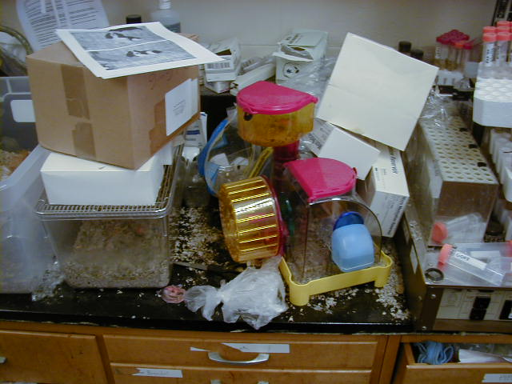
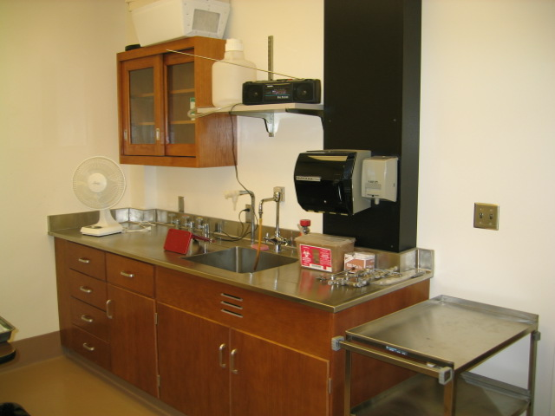
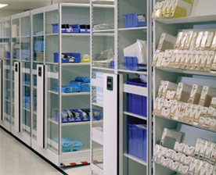
Maintain cleanliness in animal use areas
Unacceptable
Acceptable
Acceptable

Slide 12
Check for Expired drugs and Materials
Check all drawers and cabinets, refrigerators and freezers as well as bench-tops in any animal use spaces for expired drugs or materials.
This includes food as well as any chemical agents and preparations administered to animals.
Expired substances or materials must be properly disposed or clearly segregated (as in a bag) and clearly marked as “Expired, not for use in animals”
https://www.ehs.pitt.edu/waste-disposal/controlled-substances-disposal
Notes:
Next take back October 12

Slide 13
Considerations for hand sanitized equipment
Standard operating procedures must be used to ensure consistent and regular disinfection of equipment.
All hand sanitized equipment will be periodically evaluated as part of our Post-Approval Monitoring Program. This requires you to be enrolled in the program which validates the effectiveness of your hand sanitization procedures.

Slide 14
Expectations for compliance
Part II

Slide 15
Survival Surgery at Pitt
Must follow the University of Pittsburgh IACUC’s Surgical Policy which describes:
  Sterilization of instruments and supplies
  Surgical preparation of animal and surgeon
    Surgeon must wear a surgical mask, hair cover, clean and dedicated lab coat or scrubs, and sterile gloves (standard animal facility and lab gloves are not sterile!)
  Anesthesia monitoring
    An anesthetized animal cannot be left unattended
  Analgesic administration consistent with your protocol description
  Post-Operative Care
The IACUC Surgical Policy can be accessed at www.iacuc.edu under the compliance tab.
Notes:
Policy discusses major issues presented here

Slide 16
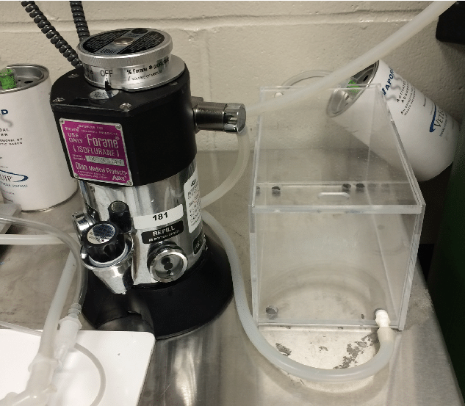
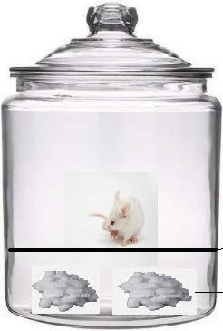
Inhalant Anesthesia
Use anesthetics only as described in the protocol.
Gas anesthetic vaporizers must be calibrated every 2 years or per manufacturer.
Gas anesthetic agents must be appropriately scavenged.
Animals must not be in contact with liquid anesthetic agents, i.e. isoflurane.
separator
Notes:
Mention disposal of isoflurane bottles by triple rinse and put in regular trash. Also, reinforce calibration and maintenance documentation

Slide 17

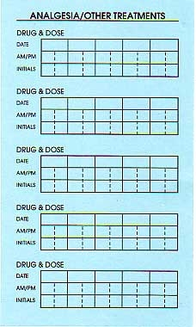
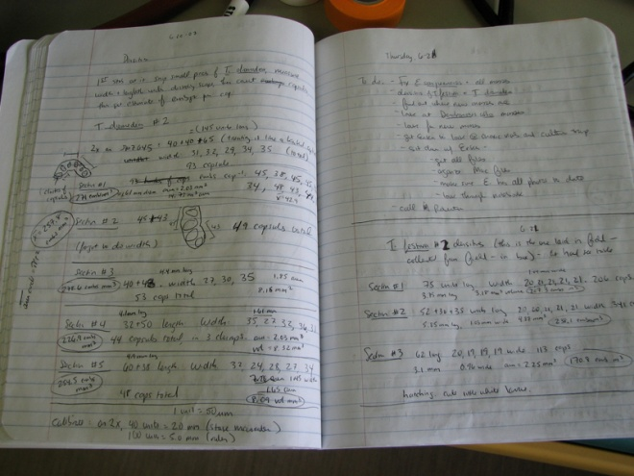
Documenting Procedures
Blue Procedure Cards
Research Records
Dates, procedures, observations, initials
Write legibly
front
back
Notes:
Use no abbreviations unless fully written out once on card or the abbreviation is listed in a key posted in housing room

Slide 18
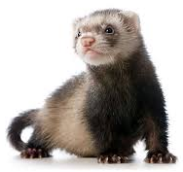
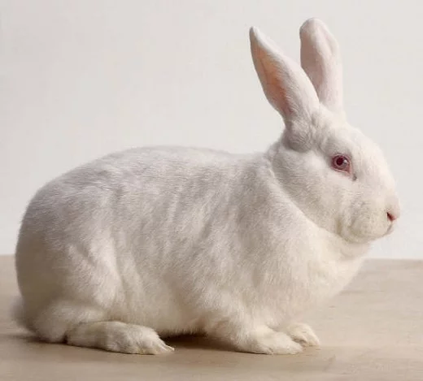
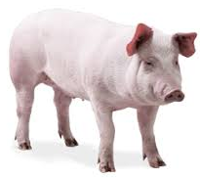

Clinical Records for Non-Rodent Mammals
Each animal must have an individual clinical record.
A post-procedure form must be completed for every
procedure done on the animal, including euthanasia.
Vital signs must be recorded at least every 15 minutes during surgery (including non-survival surgeries) using the anesthetic monitoring form .

Slide 19
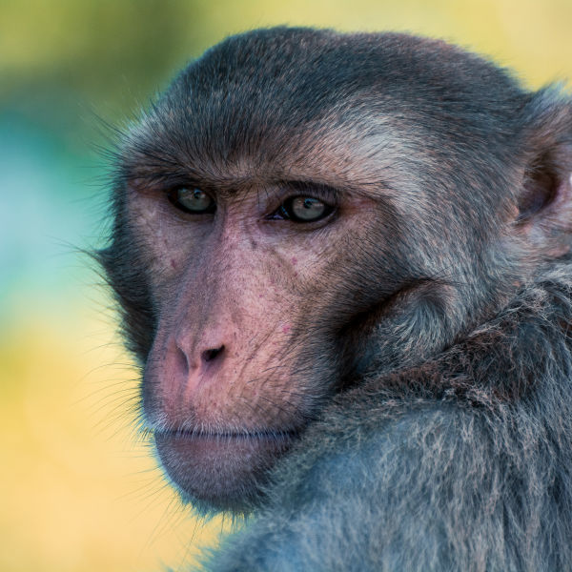
Clinical Records for Non-Rodent Mammals
Clinical records are maintained in electronic
format in CAMS.
All drugs administered to an animal by
research personnel must be documented
on clinical record/procedure forms.
Completed hard copy clinical record/procedure forms must be scanned and submitted to DLAR Veterinary Services.

Slide 20
Drugs
Only use those drugs listed in the protocol
Drugs must be pharmaceutical grade unless otherwise approved in protocol
Other drugs needed for clinical care must be under the direction of a veterinarian
Use only in-date drugs and maintain a system for identifying and disposing of expired drugs
Follow University of Pittsburgh Controlled Substances Guidelines

Slide 21
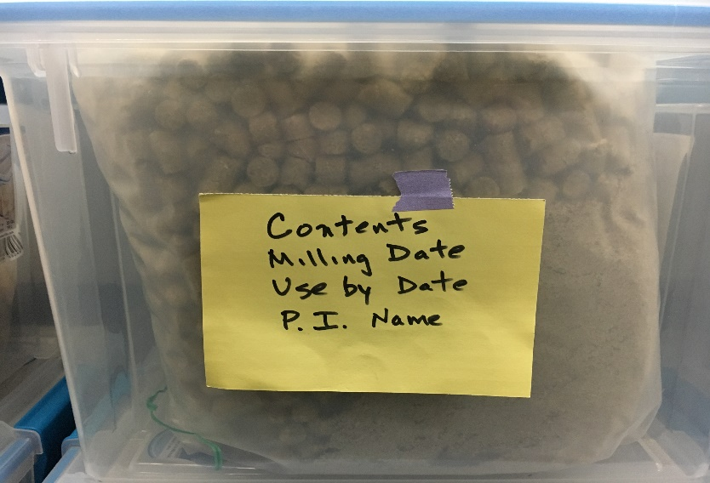
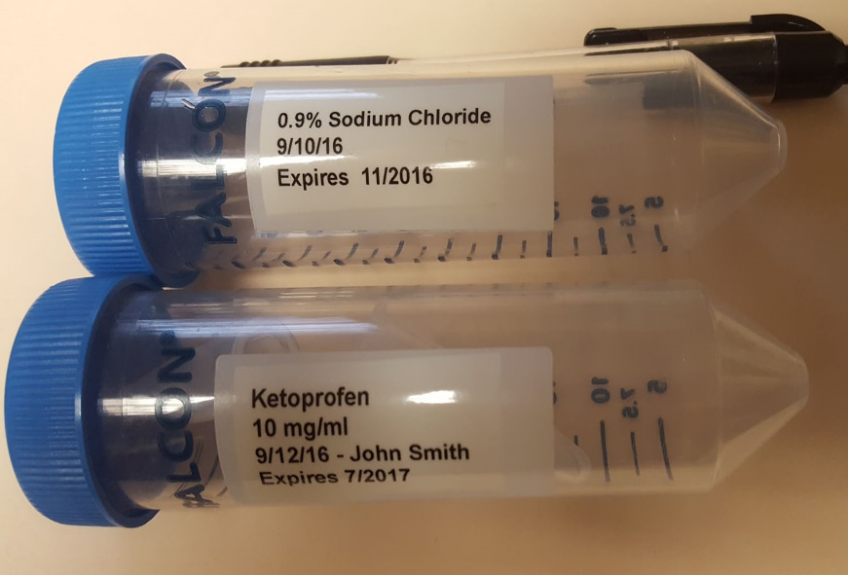
Labeling Secondary Containers
Clearly identify contents of animal diets
Chemicals and drugs must be labeled with contents, concentration, date prepared, expiration date, PI name (if in common use area in AF)
Refer to Secondary Labeling of Containers SOP

Slide 22
Animal Transport
Use only the transport routes approved in the protocol
Use only approved transport containers
Refer to the IACUC Animal Transport Policy

Slide 23
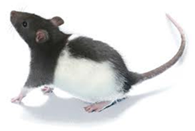
Animal Health Issues?
Post-procedure complications. What do you do?
What do you do with a sick animal on the weekend?
Do you know the point at which the animal should be euthanized?
What is approved in the protocol?
Remember: ALL clinical care of animals must be coordinated through the Division of Laboratory Animal Resources (DLAR).
Do you know your DLAR facility assigned veterinarian?

Slide 24
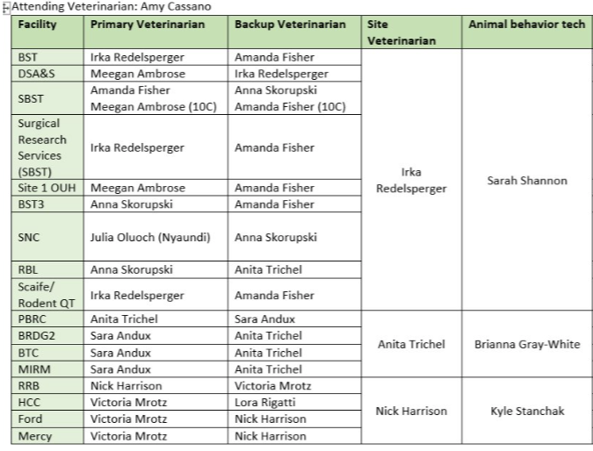
DLAR Facility Veterinarians

Slide 25
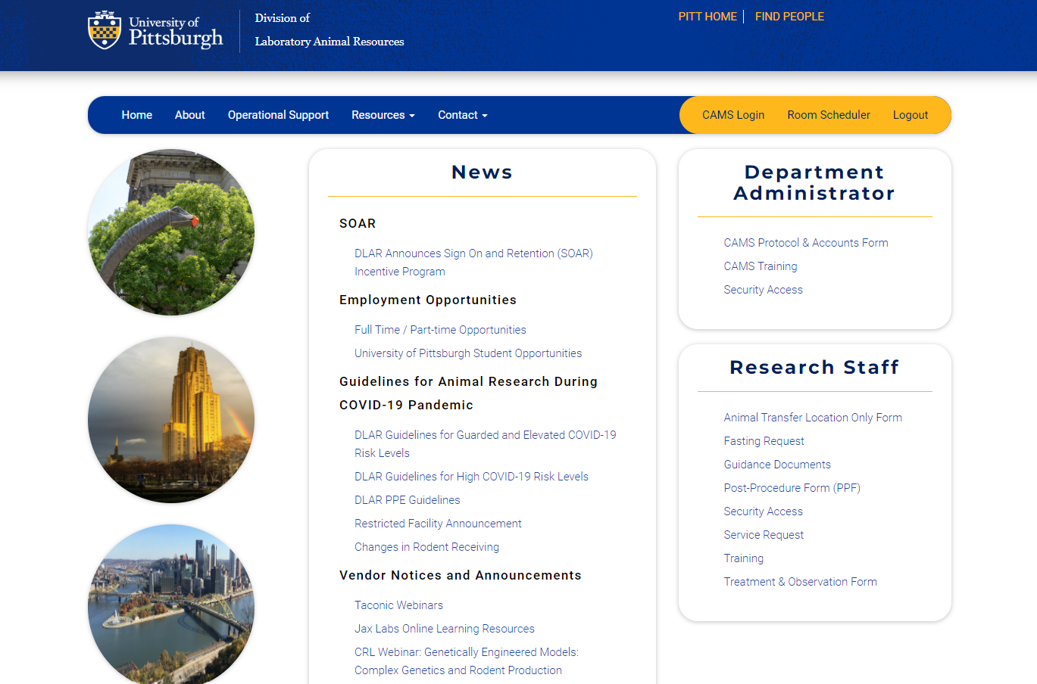
Helpful Information on the DLAR Web Site

Slide 26
Hosting Academic Visitors at the University of Pittsburgh
The University administers an Academic Visitor Process through the Office of Research Protections, which serves as the central mechanism for screening all individuals seeking academic visitor status.
Visitors who require access to animal facilities or animal procedural areas are subject to additional layers of review. This enhanced scrutiny includes confirmation that the University’s Academic Visitor Process has been fully completed, as well as verification that all mandated medical surveillance, compliance, and training requirements have been satisfactorily met prior to entry.
https://www.iacuc.pitt.edu/compliance/visitor-guidelines
Notes:
Minor children of University faculty, volunteers, staff and students are not authorized to be in laboratories, maintenance shops or other restricted areas on an attended or unattended child care basis. As stated in the University’s safety manual; visitors to restricted areas.

Slide 27
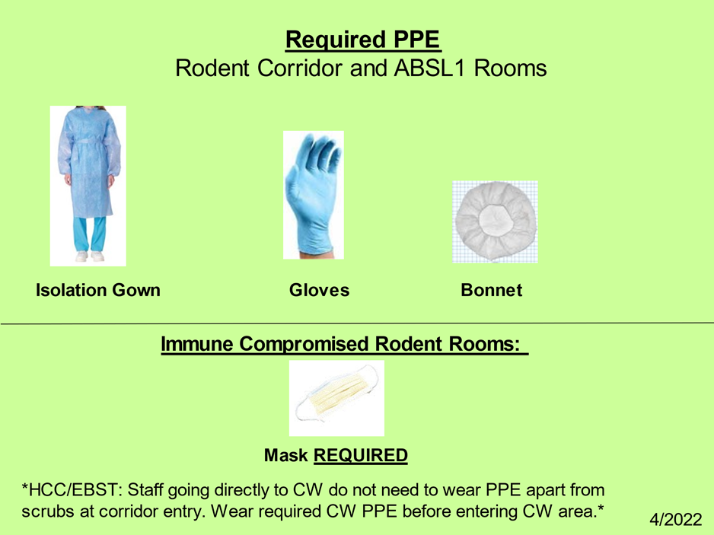
Personal Protection Equipment (PPE) Requirements in Facilities
Follow the signs & properly wear required PPE!!
Surgical mask

Slide 28



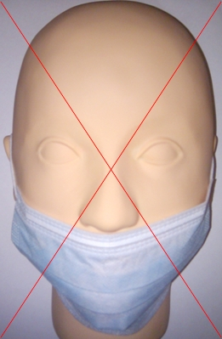
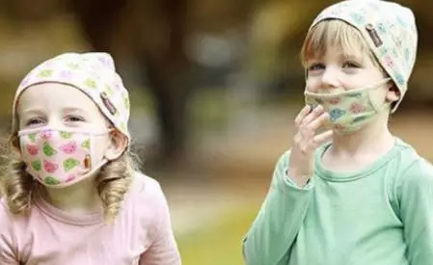

Slide 29

Animal Housing
Minimum cage space requirements are listed in the Guide, the Animal Welfare Act & Regulations, and summarized in DLAR POL 112 (Minimum Space Requirements of Primary Enclosures) posted on the DLAR website.
Overcrowded mouse cages primarily result from
  Overdue weaning (> 28 days)
  Multiple litters in the same cage
Managing rodent breeding colony cage density is the PI’s responsibility and must be described in the protocol.

Slide 30
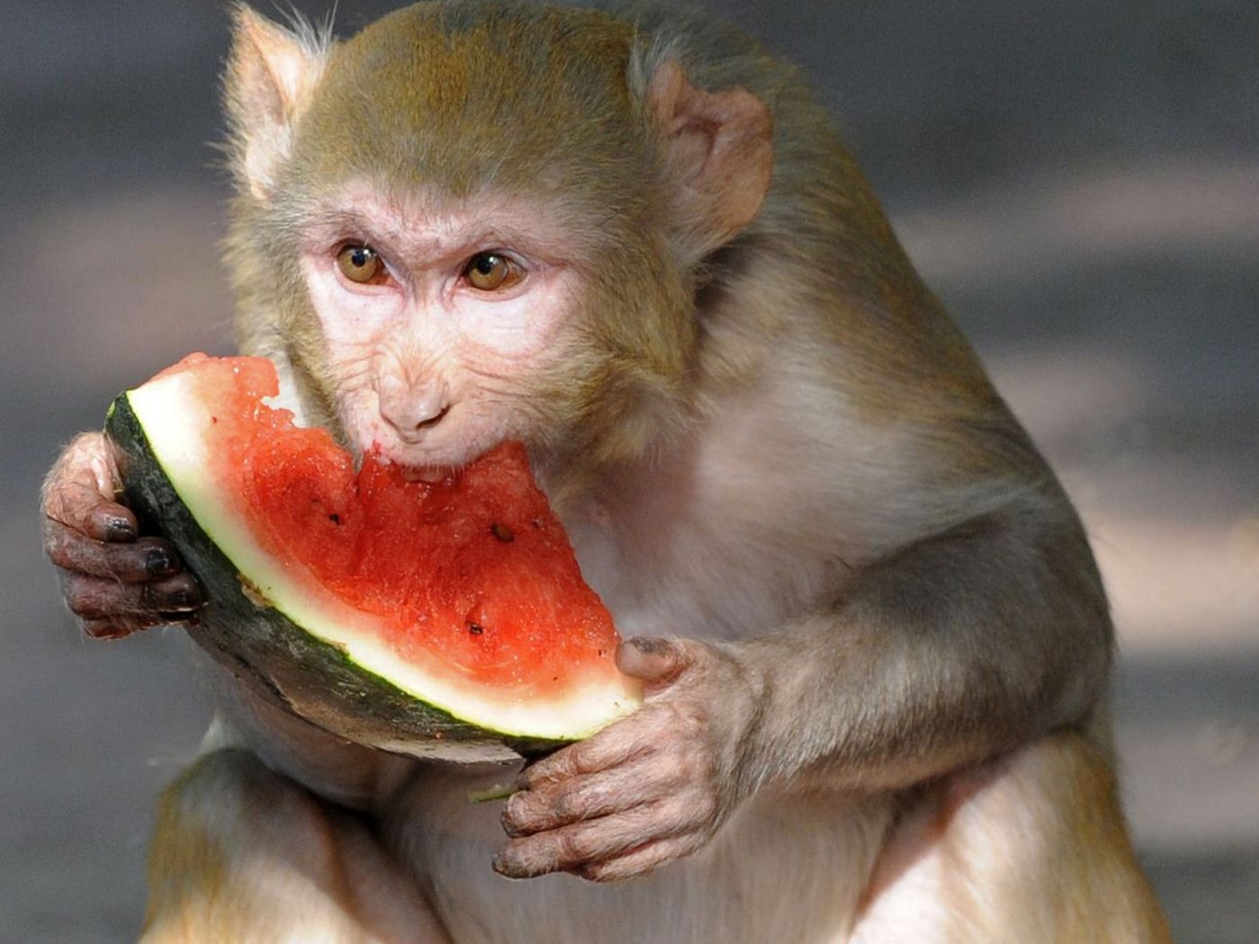
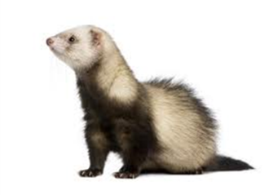
Animal Housing
A CAMS generated cage card with the bar code must be on every cage
CAMS card must have EH&S biohazard and/or chemical hazard sticker visible.
Animals cannot be housed outside of the designated animal facility unless approved by the IACUC.

Slide 31
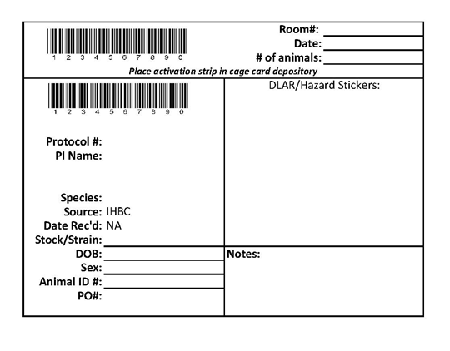
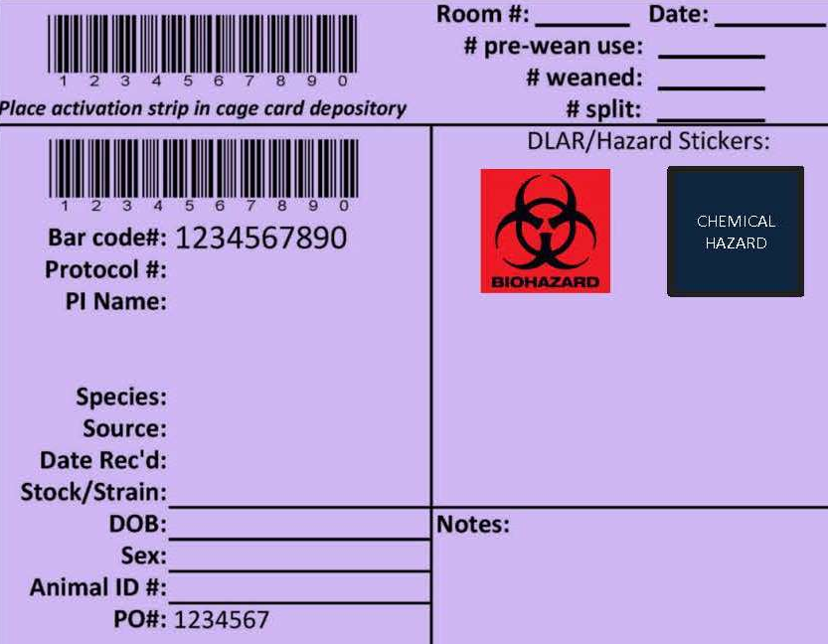
CAMS Cage Cards
Receiving Card:
Separating/Weaning Card:

Slide 32
Social Housing
Social (pair or group) housing is the default method of housing for social species
  Single housing of social species must be done in accordance with the IACUC Social Housing Policy
  Scientific basis outlined in the approved protocol
  Veterinary exemption for health/welfare concerns
  Program wide exemptions (post-op, specific breeding colony situations, research attrition, aggression or social incompatibility, male rabbits)

Slide 33
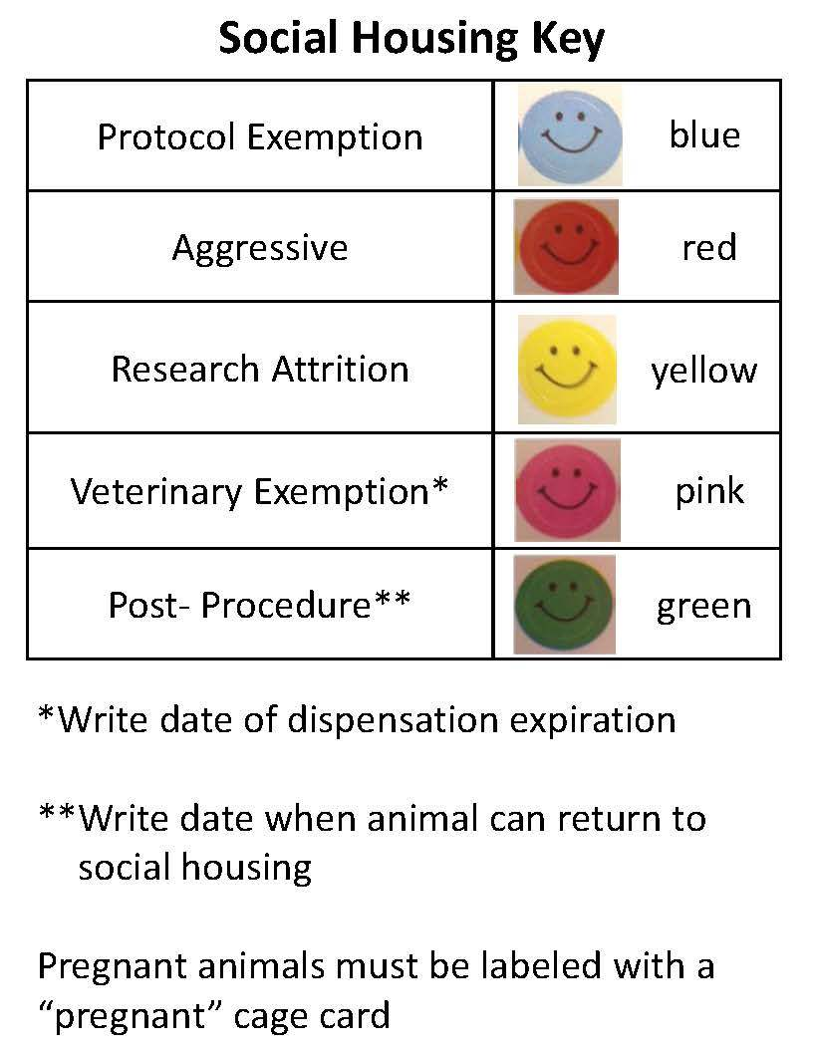
Identify Single Housed Animals
Rationale for single housing must be provided at the cage level
Appropriate colored “dot” sticker should be placed on the CAMS card

Slide 34
Expectations for Maintaining Safety

Slide 35
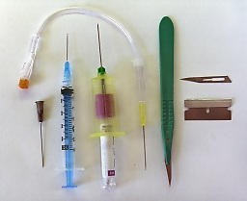
Sharps Safety
Sharps injuries are a significant injury and health hazard for researchers and animal care workers
Sharps include:
Needles, scalpel blades, lancets, razor blades, and broken glass
Notes:
Sharps injuries are an effective way to introduce infectious materials into the body.

Slide 36
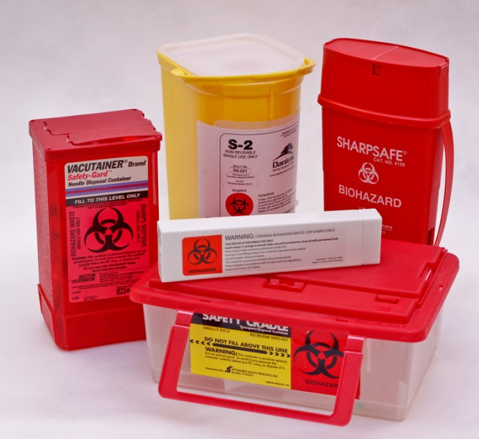
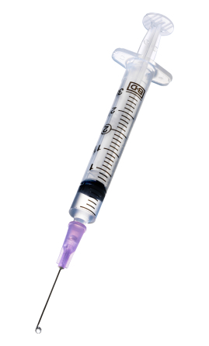
Sharps Safety
Reducing the hazard from sharps requires the use of:
Engineering controls
  Equipment designed to reduce risk
Work practice controls
  Handling practices that reduce the risks of exposure

Slide 37
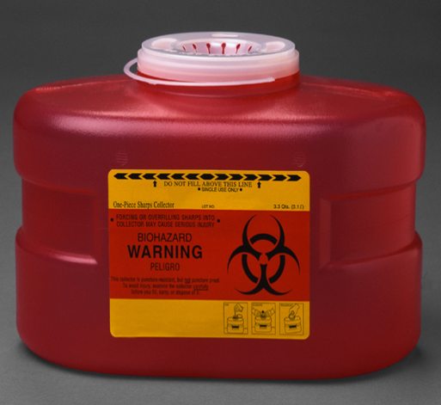
Making Sharps Use Safer
Engineering Controls
Puncture Resistant Sharps Containers
  Required for sharps disposal
  Available in immediate workspace
  Do not recap needles for disposal
  Syringes should be empty for disposal
  Use of some chemicals may require a dedicated sharps container labeled for the chemical hazard.
  Do not over fill – 2/3 full only!
Notes:
Engineering controls are the first and preferred method of reducing the risk of injury when using sharps. Sharps containers are a standard engineering control that must be available in spaces where sharps are used, in the immediate workspace. Sharps should never be collected for later disposal, but placed in the container immediately after use. Syringes exposed to certain chemical hazards, but not biological hazards should be labeled with an orange chemical waste sticker, with other labeling blacked out.

Slide 38
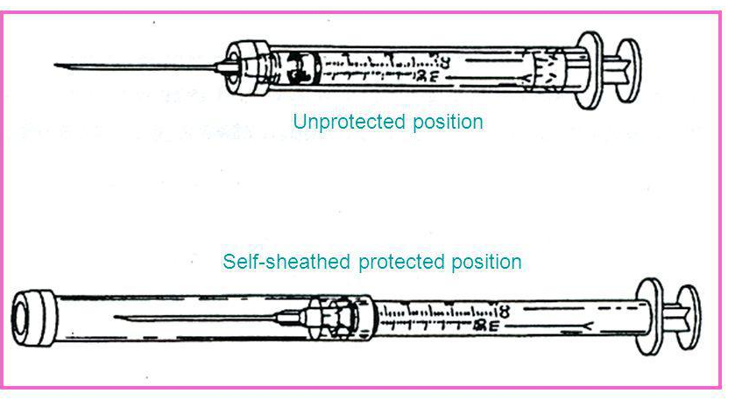
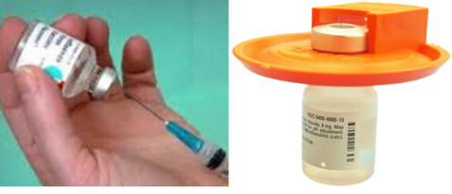
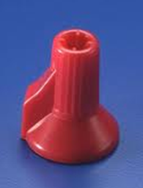
Making Sharps Use Safer
Self-sheathing needle
Engineering Controls - control the hazard by reducing/removing it
  Self sheathing needles
  Mechanical recapping devices
  Shields
Mechanical Needle Recapping Device
Needle Shield
Notes:
Specially designed sharps and supportive devices can be used to reduce the risk of injury. Recapping needles should be avoided, and needles are never recapped before disposal. When necessary as a standard practice for non-infectious materials, a mechanical recapping device can be used. For an unplanned need to recap a syringe, a one handed method should be used, with the “extra” hand kept behind the back and out of the way. Other devices, such as forceps can also be used to remove the researcher’s hands from the field of work.

Slide 39
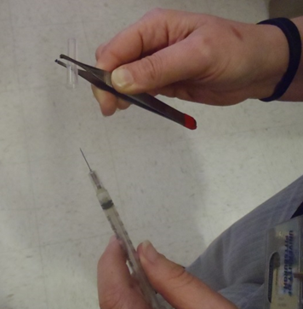
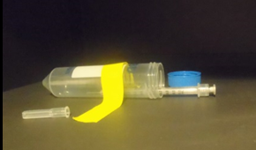
Making Sharps Use Safer
Work Practices
  Eliminate the use of sharps and glass whenever possible
  Use safety engineered sharps
  Train users in proper sharps handling, and review accident procedures
  Housekeeping
  Minimize “two handed” sharps techniques
Notes:
Sharps used as part of your procedures should be evaluated for the potential to remove or reduce their use. This includes reducing the use of glass items, such as Pasteur pipettes and slides. When a device is needed, a design with a safety feature should be considered. Training laboratory members in appropriate sharps handling reduces the risk of injury to themselves (and others when working in teams). Sharps devices should never be left out unattended. Sharps being prepared for use can be stored in a container that encloses the sharp to avoid potential exposure. Sharps should not be left in labcoats or disposed of in general trash. Two handed handling techniques should be avoided.

Slide 40
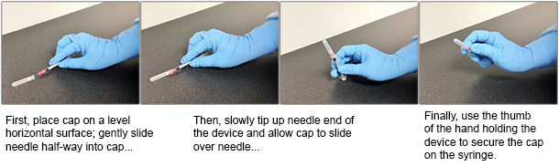
One-Handed Recapping
from Vanderbilt EH&S

Slide 41

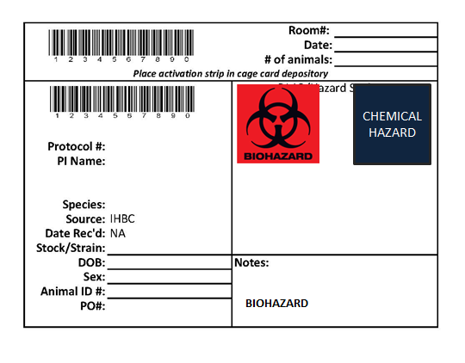

Chemicals
All chemical containers must be labeled
See “IACUC Policy on Secondary Labeling”
An expiration date must be on the label of all drug containers
Keep chemicals away from human or animal food items
Fume hoods and Biological Safety Cabinets must be certified annually
Tamoxifen
Notes:
Contact EHSS for any additional questions about disposal or handing. Chemicals that are no longer in use or wanted should be labeled for disposal. When possible, limit the amount of chemicals stored in animal procedure spaces.

Slide 42
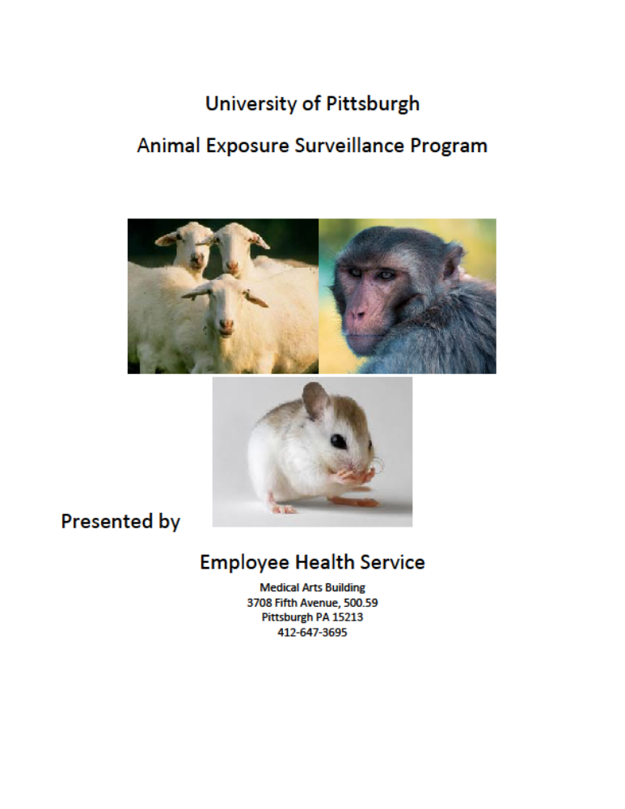
Occupational Health and Safety
All animal users must be enrolled in the Animal Exposure Surveillance Program (AESP), and update information every 3 years and/or if they experience any injuries or allergy symptoms.
http://www.ehs.pitt.edu/biological/animal.html

Slide 43
Occupational Health and Safety
Injuries and Exposure Response:
Employees and Students should know the process!
Wash bite or exposed area with soap and water (or flush eyes and mouth with water)
Report the incident to your supervisor
Report for treatment to Employee Health (business hours) or UPMC Presbyterian Emergency Dept. (after 3:30 pm)
Complete reporting process to Workman’s Comp within 24 hours (1-800-633-1197)
Notes:
For Emergency response, call University Police for assistance.

Slide 44
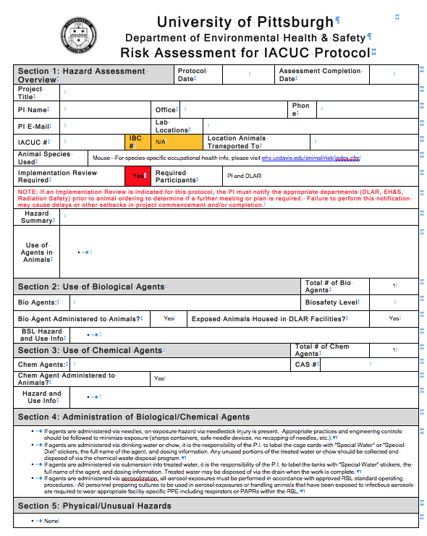
Occupational Health and Safety
IACUC Protocol Hazard Assessment:
EH&S risk assessment provides guidance on:
  Chemical, biological and physical risks
  Engineering Controls
  PPE worn during procedures involving the agents or physical hazard
  Training and Medical Surveillance Requirements
  Implementation Meeting Requirement
Notes:
Engineering controls include: use of fume hoods/biosafety cabinets etc. EH&S can also provide additional guidance on waste disposal.

Slide 45
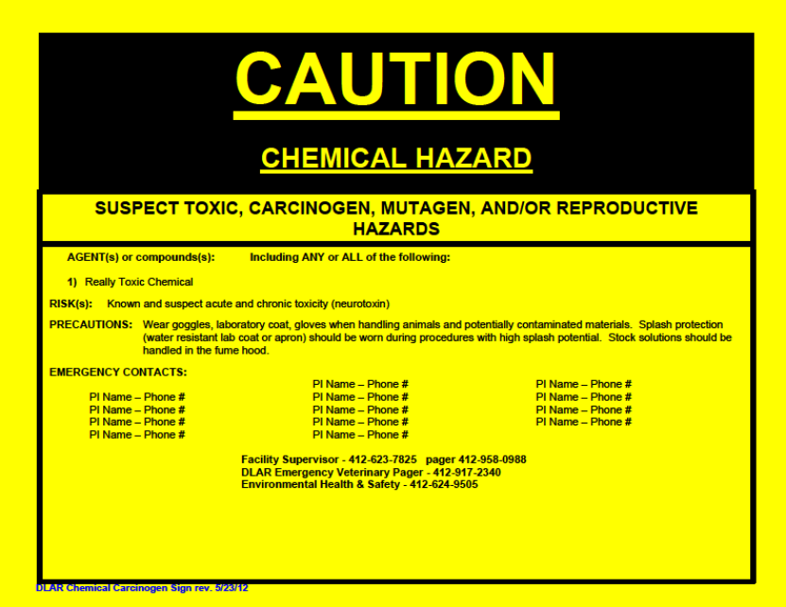
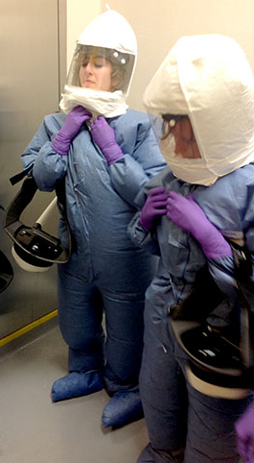
Occupational Health and Safety
Animal users should know:
Standard procedures (ex. decontamination)
Hazards present in the animal room
What PPE to wear
How to respond to an exposure or animal bite

Slide 46
IACUC Policy Updates and Revisions
IACUC Policies, Guidelines and SOPs are updated frequently and are indicated as such on the
IACUC Policy page. Please check back often at:
https://www.iacuc.pitt.edu/policies-sops-guidelines
University of Pittsburgh policies are designed to maintain a program consistent with the Guide for the Care and Use of Laboratory Animals
Notes:
e.g., AVMA euthanasia guidelines updated 2013

Slide 47
Please contact us if you have any questions
Animal Research Protection Office
412-383-2008
IACUC@pitt.edu
DLAR Main Office
412-648-8950
DLAR@pitt.edu
Notes:
Offer assistance to help with your research endeavors

Slide 48
Other Resources
AAALAC site visit AAALAC International – Preparing for a site visit-slides
iacuc.pitt.edu Animal Research Protection Office
orp.pitt.edu Office of Research Protections
cme.hs.pitt.edu Internet-based Studies in Education and Research- training modules
ibc.pitt.edu Institutional Biosafety Committee
dlar.pitt.edu Division of Laboratory Animal Resources
ehs.pitt.edu Environmental Health and Safety Office

